Slide 1
Reference: A new LSTM based reversal point prediction method using upward/downward reversal point feature sets
Source: ScienceDirect
Abstract: A novel Long-Short Term Memory (LSTM)-based prediction model of stock price reversal point was proposed by using upward/downward reversal point feature sets.
Based on the combinations of candlestick indicators and technical indicators, 27 sets of feature candidates were constructed, and then the feature sets suitable to each stock in terms of URP/DRP prediction were respectively extracted.
LSTMbased URP/DRP predictors were constructed, the results of which are combined to improve the prediction accuracy. Using this model, reversal point prediction has been conducted for 10 Chinese stocks and 10 American stocks. In results, the mean prediction accuracy (F1) was 68.6% and 55.2% for the Chinese and the American stock markets, respectively.

Slide 2
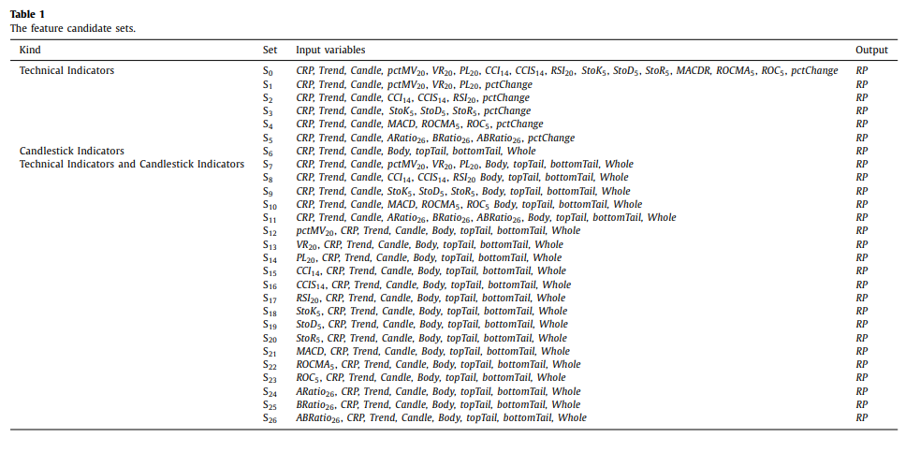

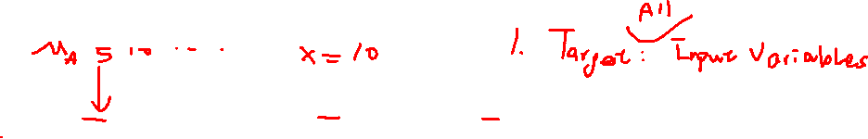
feature candidate sets

Slide 3
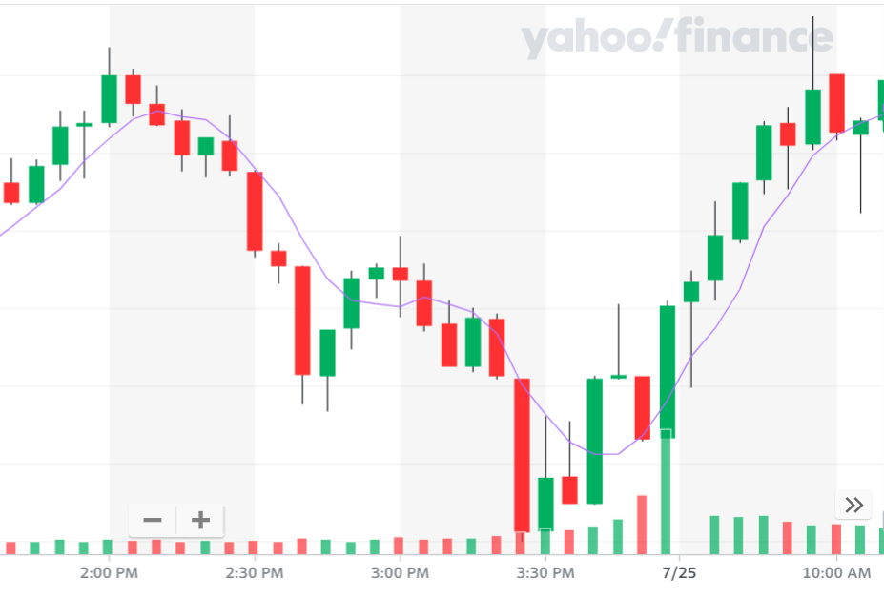


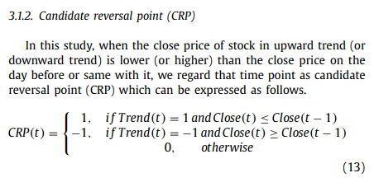
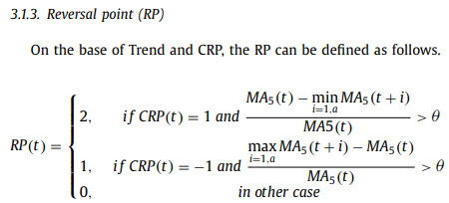
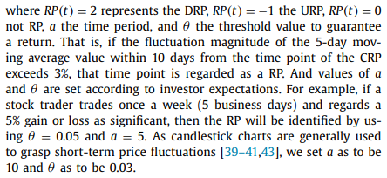


Reversal point definition
Trend = 1
CRP = 1
RP = 1

Slide 4

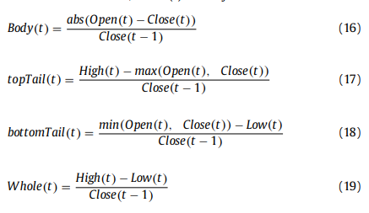
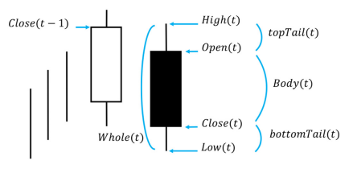
Feature set : The candlestick indicators

Slide 5
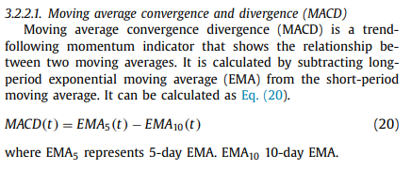
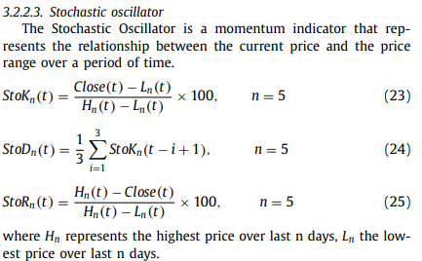
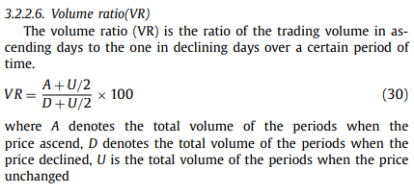
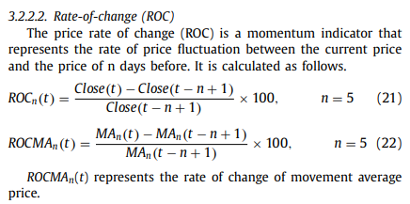
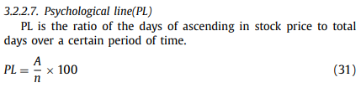
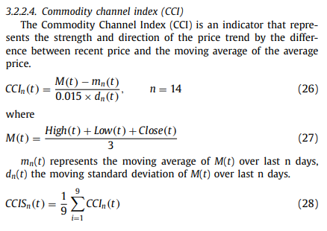
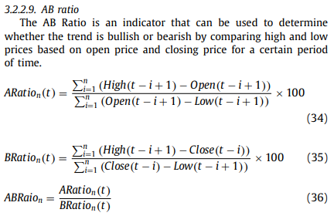
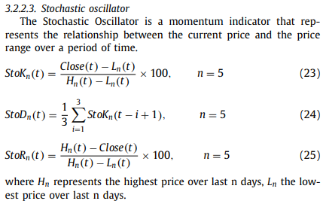
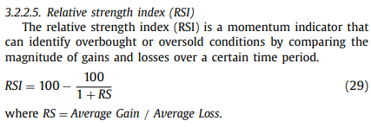


Feature set : The technical indicators

Slide 6
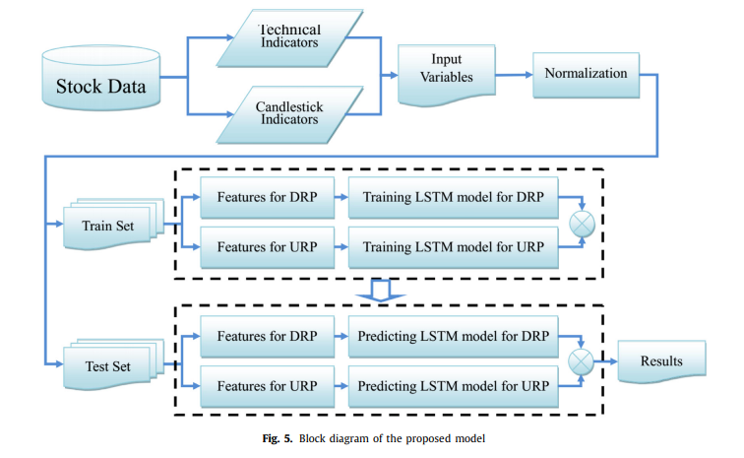
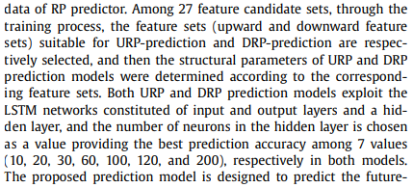

The LSTM based predict model using upward/downward reversal point feature set

Slide 7
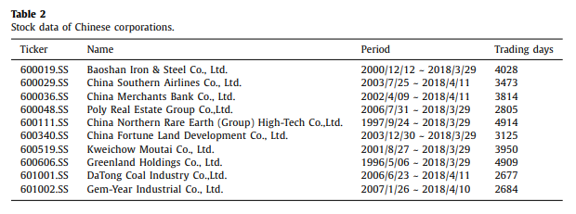
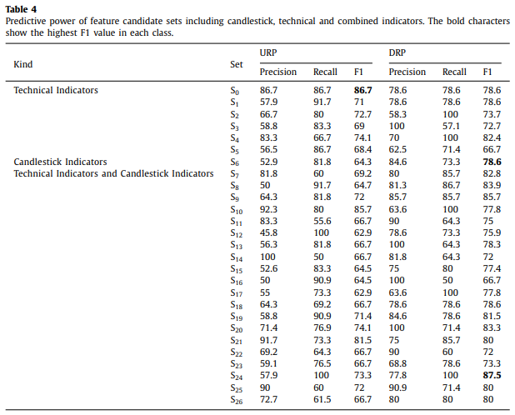
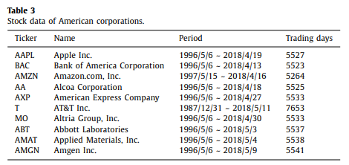
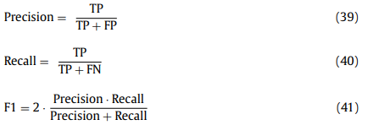
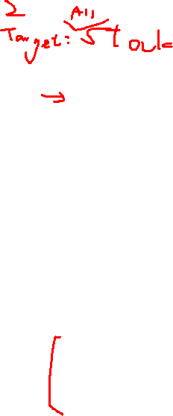
Experimental results and discussion

Slide 8
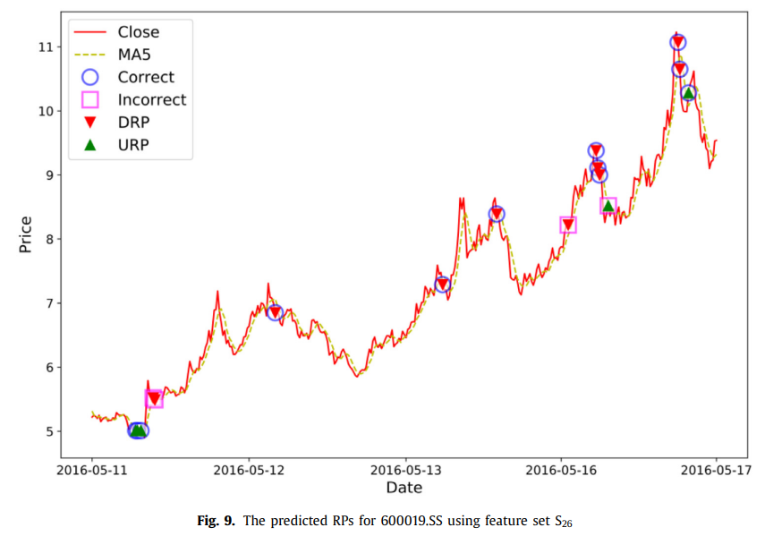
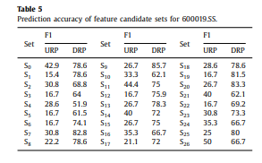
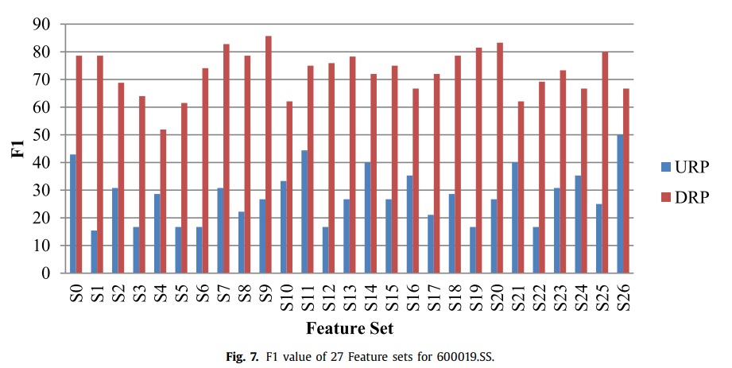
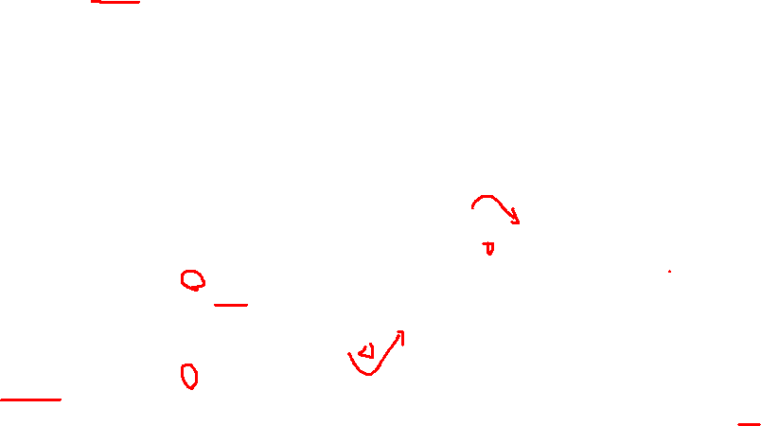
Performance evaluation of feature candidate sets

Slide 9
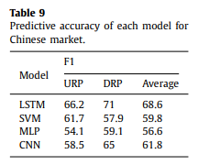
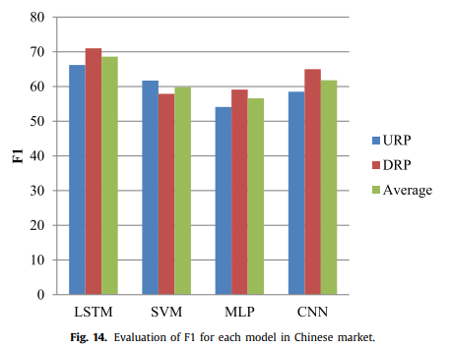


Evaluation

Slide 10

Practice
Flow chart
下載資料
計算特徵
正規化
分割訓練和測試數據
創建LSTM數據集
建立LSTM模型
訓練模型
預測
反正規化預測結果
將連續值轉換為二進制
評估模型
Feature set
X:
Moving Average
RSI
MACD
Bollinger Bands
Stochastic Oscillator
Trend
CRP
Candle
Y:
RP

Slide 11

single-step

Slide 12
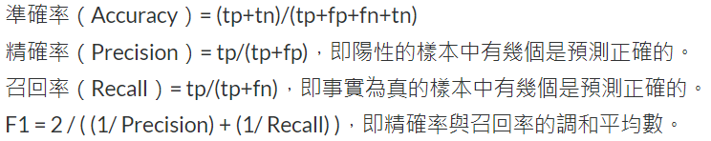
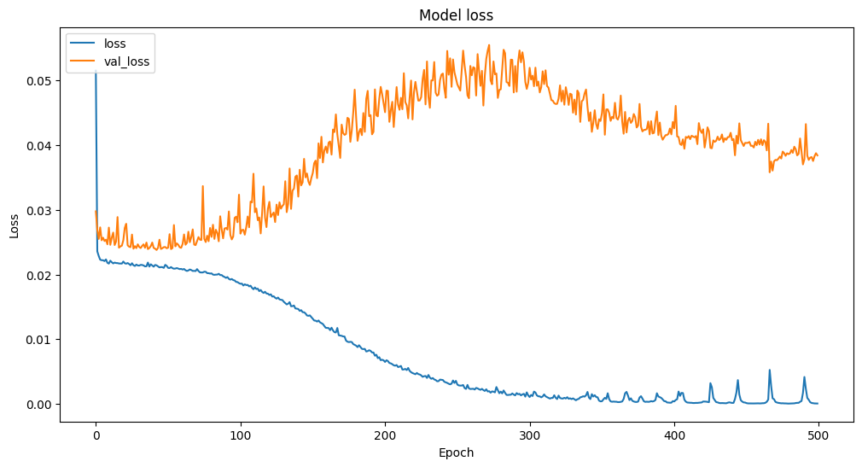
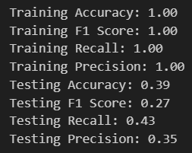
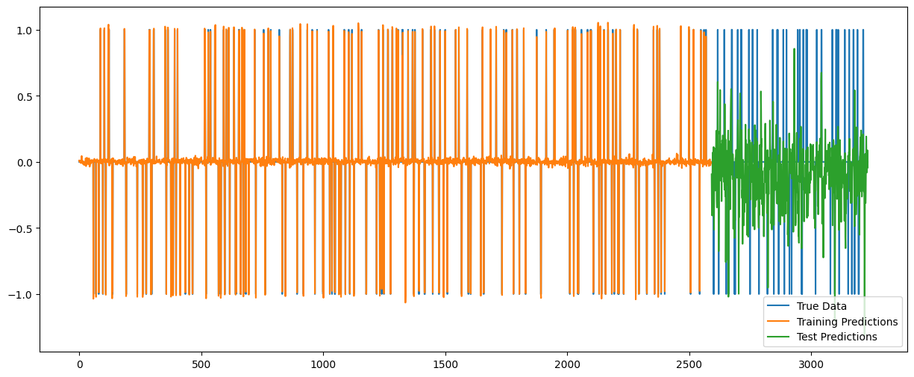
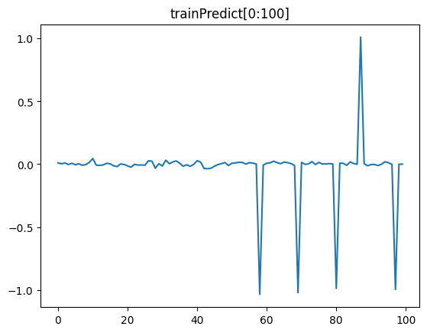

Result evaluation
Y
0.1
-0.1

Slide 13
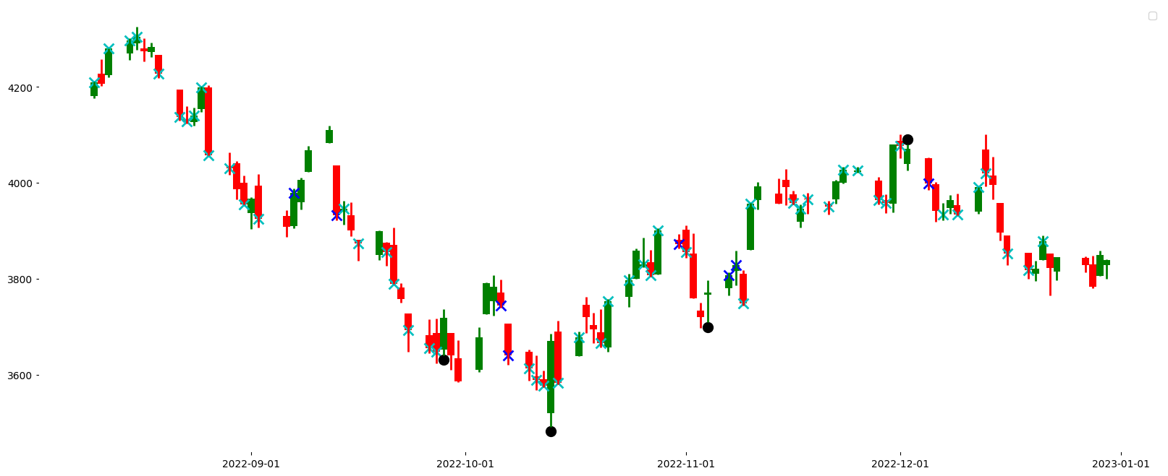
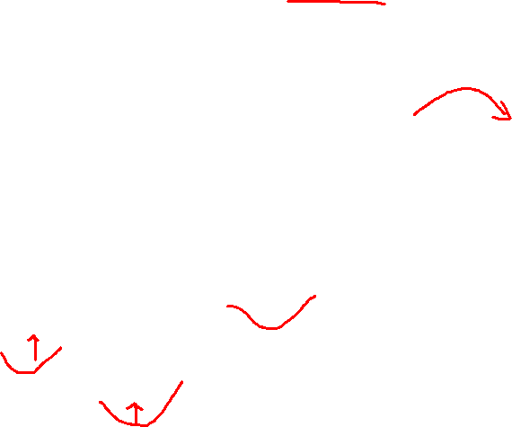
Result evaluation
pred_value != '0' and true_value == ‘0’ ,(False Positive, FP) : Royal blue X
true_value != ‘0’ and pred_value == ‘0‘ ,(False Negative, FN): blue X
Correct: black X

Slide 14
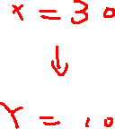
multi-step

Slide 15
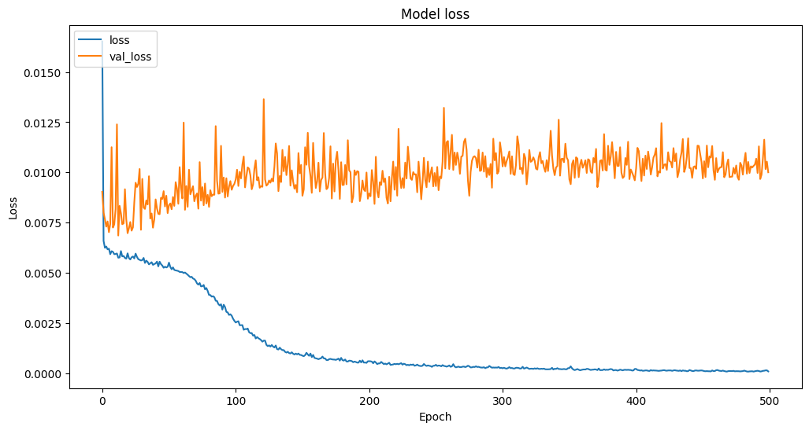
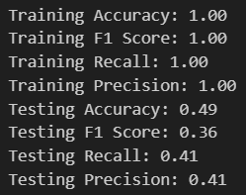
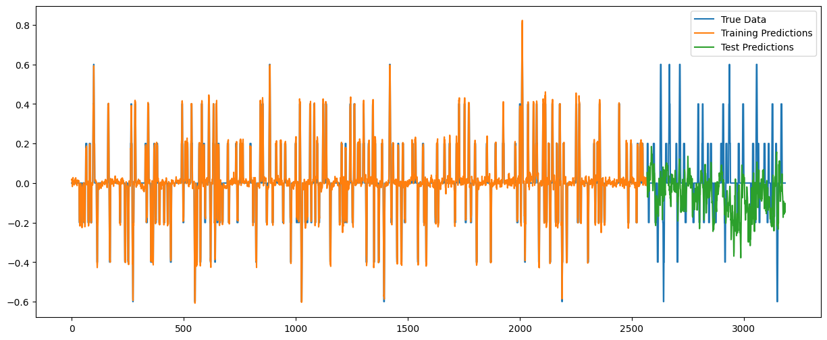
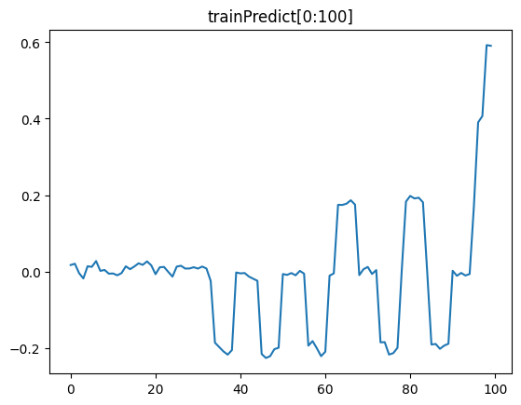


Result evaluation
Y
0.1
-0.1

Slide 16
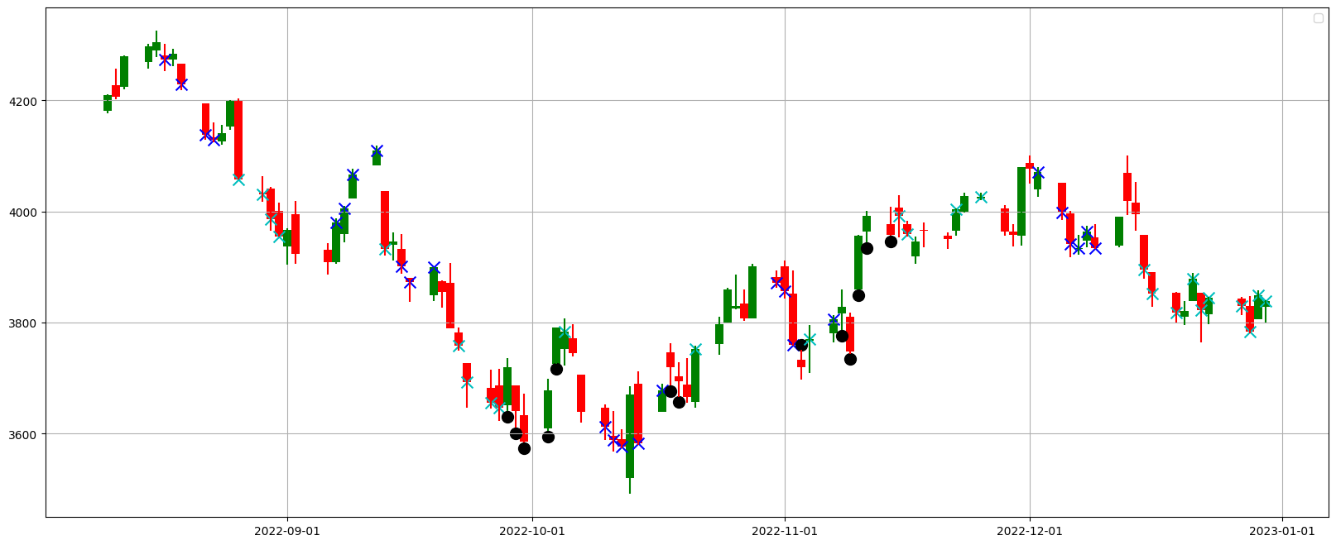

Result evaluation
pred_value != '0' and true_value == ‘0’ ,(False Positive, FP) : Royal blue X
true_value != ‘0’ and pred_value == ‘0‘ ,(False Negative, FN): blue X
Correct: black X

Slide 17
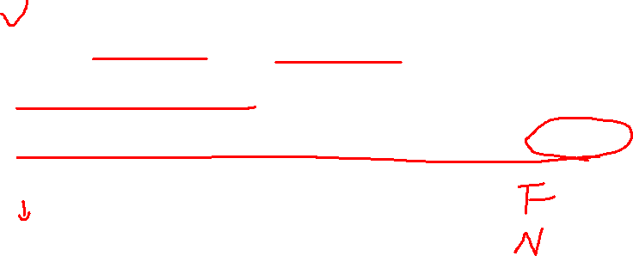
Improve
From single-step to multi-step
Extend feature sets
Append comparison between different model
…

Slide 18
Reference:
Author: Summary:
Analysis:
Conclusions:
1.

Slide 19
Reference:
Author: Summary:
Analysis:
Conclusions:
1.

